Slide 1
Advanced Counting Techniques

Slide 2
8 Advanced Counting Techniques
8.1 Recurrence Relations
8.2 Solving Recurrence Relations
Linear homogeneous recurrence relations with constant coefficients of degree k （k阶齐次常系数线性递推关系）
8.3 Divide-and-Conquer Algorithms and Recurrence Relations
8.4 Generating Functions
8.5 Inclusion-Exclusion
8.6 Applications of Inclusion-Exclusion

Slide 3
Recurrence Relations (递推（归）关系)

Slide 4
Definition
The recursive definitions of sequences are examples of recurrence relations.
When the problem is to find an explicit formula for a recursively defined sequence, the recursive formula（递归公式） is called a recurrence relation（递推关系）.

Slide 5
Remember
To define a sequence recursively, a recursive formula must be accompanied by information about the beginning of the sequence.
This information is called the initial condition (初始条件）or conditions for the sequence.

Slide 6
§8.1: Recurrence Relations
A recurrence relation (R.R., or just recurrence) for a sequence {a_{n}} is an equation that expresses a_{n} in terms of one or more previous elements a₀, …, a_{n−1} of the sequence, for all n≥n₀.
A recursive definition, without the base cases.
A particular sequence (described non-recursively) is said to solve the given recurrence relation if it is consistent with the definition of the recurrence.
A given recurrence relation may have many solutions.

Slide 7
Recurrence Relation Example
Consider the recurrence relation
a_{n} = 2a_{n−1} − a_{n−2} (n≥2).
Which of the following are solutions? a_{n} = 3n a_{n} = 2^{n}
a_{n} = 5
Yes
No
Yes

Slide 8
Example Applications
Recurrence relation for growth of a bank account with P% interest per given period:
M_{n} = M_{n−1} + (P/100)M_{n−1}
Growth of a population in which each organism yields 1 new one every period starting 2 periods after its birth.
P_{n} = P_{n−1} + P_{n−2} (Fibonacci relation)

Slide 9
Solving Compound Interest RR
M_{n} = M_{n−1} + (P/100)M_{n−1}
= (1 + P/100) M_{n−1}
= r M_{n−1} (let r = 1 + P/100)
= r (r M_{n−2})
= r·r·(r M_{n−3}) …and so on to…
= r^{n} M₀

Slide 10
Rabbits and the Fiobonacci Numbers
Example: A young pair of rabbits (one of each gender) is placed on an island. A pair of rabbits does not breed until they are 2 months old. After they are 2 months old, each pair of rabbits produces another pair each month. Find a recurrence relation for the number of pairs of rabbits on the island after n months, assuming that rabbits never die.
This is the original problem considered by Leonardo Pisano (Fibonacci) in the thirteenth century.

Slide 11
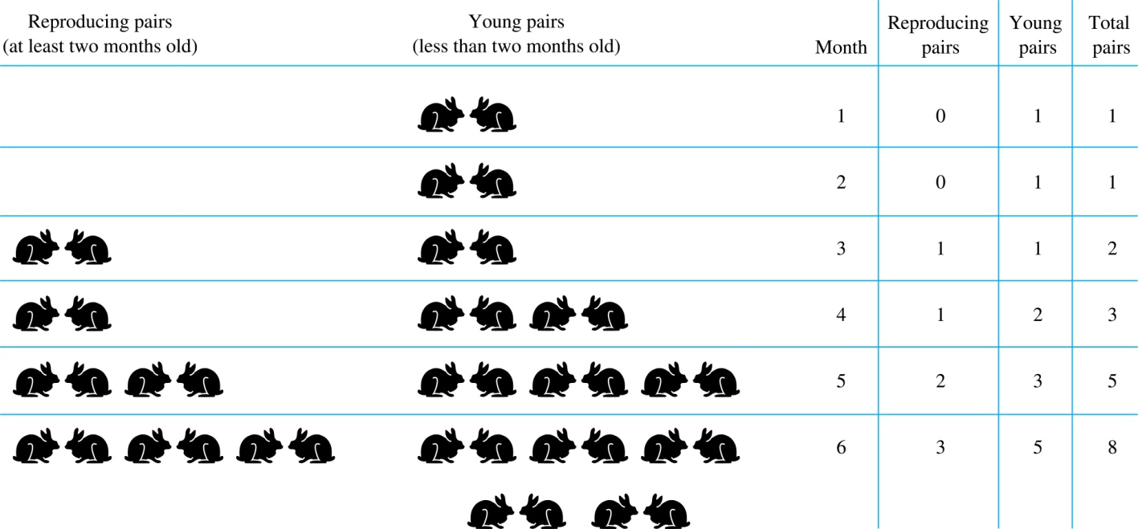
Rabbits and the Fiobonacci Numbers (cont.)
Modeling the Population Growth of Rabbits on an Island

Slide 12
Rabbits and the Fibonacci Numbers (cont.)
Solution: Let f_{n} be the the number of pairs of rabbits after n months.
There are is f₁ = 1 pairs of rabbits on the island at the end of the first month.
We also have f₂ = 1 because the pair does not breed during the first month.
To find the number of pairs on the island after n months, add the number on the island after the previous month, f_{n-1}, and the number of newborn pairs, which equals f_{n-2}, because each newborn pair comes from a pair at least two months old.
Consequently the sequence {f_{n} } satisfies the recurrence relation f_{n} = f_{n-1} + f_{n-2} for n ≥ 3 with the initial conditions f₁ = 1 and f₂ = 1.
The number of pairs of rabbits on the island after n months is given by the nth Fibonacci number.

Slide 13
The Tower of Hanoi
In the late nineteenth century, the French mathematician Édouard Lucas invented a puzzle consisting of three pegs on a board with disks of different sizes. Initially all of the disks are on the first peg in order of size, with the largest on the bottom.
Rules: You are allowed to move the disks one at a time from one peg to another as long as a larger disk is never placed on a smaller.
Goal: Using allowable moves, end up with all the disks on the second peg in order of size with largest on the bottom.

Slide 14
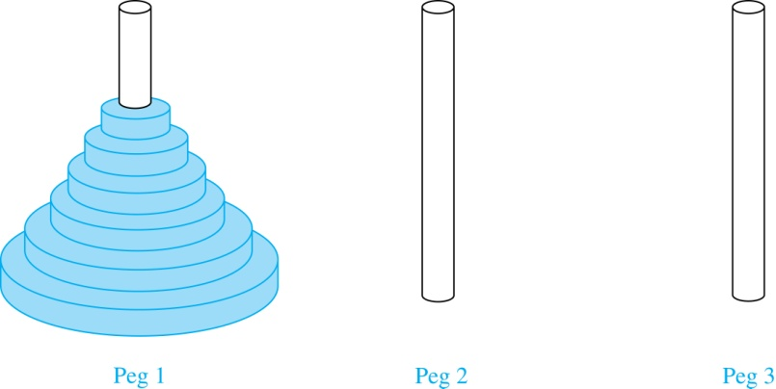
The Tower of Hanoi (continued)
The Initial Position in the Tower of Hanoi Puzzle

Slide 15
Hanoi Recurrence Relation
Let H_{n} = # moves for a stack of n disks.
Optimal strategy:
Move top n−1 disks to spare peg. (H_{n−1} moves)
Move bottom disk. (1 move)
Move top n−1 to bottom disk. (H_{n−1} moves)
Note: H_{n} = 2H_{n−1} + 1

Slide 16
Hanoi Recurrence Relation
Let H_{n} = # moves for a stack of n disks.
Optimal strategy:
Move top n−1 disks to spare peg. (H_{n−1} moves)
Move bottom disk. (1 move)
Move top n−1 to bottom disk. (H_{n−1} moves)
Note: H_{n} = 2H_{n−1} + 1

Slide 17
Solving Tower of Hanoi RR
H_{n} = 2 H_{n−1} + 1
= 2 (2 H_{n−2} + 1) + 1 = 2² H_{n−2} + 2 + 1
= 2²(2 H_{n−3} + 1) + 2 + 1 = 2³ H_{n−3} + 2² + 2 + 1
…
= 2^{n−1} H₁ + 2^{n−2} + … + 2 + 1
= 2^{n−1} + 2^{n−2} + … + 2 + 1 (since H₁ = 1)
=
= 2^{n} − 1 (From , where a=1, r=2)

Slide 18
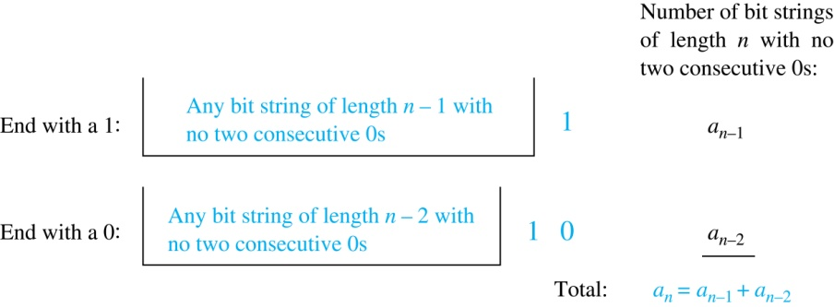
Counting Bit Strings
Find a recurrence relation and give initial conditions for the number of bit strings of length n that do not have two consecutive 0s. How many such bit strings are there of length five?
a₁ = 2， a₂ = 3， a₅ = 13

Slide 19
Example 4
A computer system considers a string of decimal digits a valid codeword if it contains an even number of 0 digits. For instance,1230407869 is valid, whereas 120987045608 is not valid. Let a_{n} be the number of valid n-digit codewords. Find a recurrence relation for a_{n}.
a_{n}=9a_{n-1}+(10^{n-1}-a_{n-1} )=8a_{n-1}+10^{n-1}

Slide 20
Counting the Ways to Parenthesize a Product
Example: Find a recurrence relation for C_{n} , the number of ways to parenthesize the product of n + 1 numbers, x₀ ∙ x₁ ∙ x₂ ∙ ⋯ ∙ x_{n}, to specify the order of multiplication.
For example, C₃ = 5,
((x₀ ∙ x₁ )∙ x₂ )∙ x₃ , (x₀ ∙ (x₁ ∙ x₂ ))∙ x₃ ,
(x₀ ∙ x₁ )∙ (x₂ ∙ x₃ ), x₀ ∙ (( x₁ ∙ x₂ ) ∙ x₃ ),
x₀ ∙ ( x₁ ∙ ( x₂ ∙ x₃ ))

Slide 21
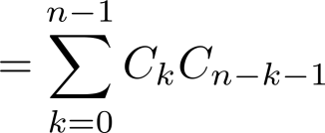
Counting the Ways to Parenthesize a Product
Solution:
This final operator appears between two of the n + 1 numbers, say x_{k} and x_{k+1}. Since there are C_{k} ways to insert parentheses in the product x₀ ∙ x₁ ∙ x₂ ∙ ⋯ ∙ x_{k} and C_{n−k−1} ways to insert parentheses in the product x_{k+1} ∙ x_{k+2} ∙ ⋯ ∙ x_{n}, we have
The initial conditions are C₀ = 1 and C₁ = 1.
The sequence {C_{n} } is the sequence of Catalan Numbers.

Slide 22
Homework
§8.1
14

Slide 23
§8.2: Solving Recurrences
General Solution Schemas
A linear homogeneous recurrence of degree k with constant coefficients (“k-LiHoReCoCo”,k阶定常系数线性齐次递推关系) is a recurrence of the form a_{n} = c₁a_{n−1} + … + c_{k}a_{n−k}, where the c_{i,} (i = 1, .., k) are all real, and c_{k} ≠ 0.
Note
On the right-hand side, the summands(被加数） are each built the same (homogeneous) way as a multiple of one of the k (degree k) previous terms (linear).
The solution is uniquely determined if k initial conditions a₀…a_{k−1} are provided.

Slide 24

多选题
1分
Which of the following relations are linear homogeneous recurrence relations?
A
c_{n}=(-2)c_{n-1}
B
a_{n}=a_{n-1} + 3
C
f_{n} = f_{n-1}+ f_{n-2}
g_{n} = g_{n-1}²+ g_{n-2}
D
提交

Slide 25
Characteristic equation (特征方程）
For a linear homogeneous recurrence relation of degree k, We call the associated polynomial of degree k, x^{k}=c₁x^{k-1}+c₂x^{k-2}+…+c_{k,}its characteristic equation (特征方程）.
The roots of the characteristic equation play a key role in the explicit formula for the sequence defined by the recurrence relation and the initial conditions.

Slide 26
Solving LiHoReCoCos
Basic idea: Look for solutions of the form a_{n} = r^{n}, where r is a constant.
This requires the characteristic equation: r^{n} = c₁r^{n−1} + … + c_{k}r^{n−k}, i.e., r^{k} − c₁r^{k−1} − … − c_{k-1}r – c_{k} = 0
The solutions (characteristic roots) can yield an explicit formula for the sequence.

Slide 27
Solving 2-LiHoReCoCos
Consider an arbitrary 2-LiHoReCoCo: a_{n} = c₁a_{n−1} + c₂a_{n−2}
It has the characteristic equation (C.E.): r² − c₁r − c₂ = 0
Thm. 1: If this CE has 2 roots r₁≠r₂, then a_{n} = α₁r₁^{n} + α₂r₂^{n} for n≥0 for some constants α₁, α₂.

Slide 28
Proof
Suppose that r₁ and r₂ are roots of r² - c_{l}r – c₂ = 0, so r₁² - c_{l} r₁ – c₂ = 0 , r₂² - c_{l} r₂ – c₂ = 0 and then a_{n} = α₁ r₁^{n} + α₂ r₂^{n}, for n≥ 1.
We show that this definition of a_{n} defines the same sequence as a_{n} =c₁a_{n-1} + c₂a_{n-2}
First we note that α₁ and α₂ are chosen so that a₁ = α₁ r₁ + α₂ r₂ and a₂ = α₁ r₁² + α₂ r₂² and so the initial conditions are satisfied. Then

Slide 29
Q.E.D

Slide 30
Example 3
Solve the recurrence a_{n} = a_{n−1} + 2a_{n−2} given the initial conditions a₀ = 2, a₁ = 7.
Solution: Use theorem 1
c₁ = 1, c₂ = 2
Characteristic equation: r² − r − 2 = 0
Solutions: r = [−(−1)±((−1)² − 4·1·(−2))^{1/2}] / 2·1 = (1±9^{1/2})/2 = (1±3)/2, so r = 2 or r = −1.
So a_{n} = α₁ 2^{n} + α₂ (−1)^{n}.

Slide 31
Example 3 Continued…
To find α₁ and α₂, solve the equations for the initial conditions a₀ and a₁: a₀ = 2 = α₁2⁰ + α₂ (−1)⁰
a₁ = 7 = α₁2¹ + α₂ (−1)¹
Simplifying, we have the pair of equations: 2 = α₁ + α₂
7 = 2α₁ − α₂ which we can solve easily by substitution:
α₂ = 2−α₁; 7 = 2α₁ − (2−α₁) = 3α₁ − 2;
9 = 3α₁; α₁ = 3; α₂ = −1.
Final answer: a_{n} = 3·2^{n} − (−1)^{n}
Check: {a_{n≥0}} = 2, 7, 11, 25, 47, 97 …

Slide 32
Example 4
The Fibonacci sequence is defined by a linear homogeneous recurrence relation of degree 2, so by Theorem l, the roots of the associated equation are needed to describe the explicit formula for the sequence.
From f_{n}=f_{n-1}+f_{n-2} and f₁=f₂=1, we have x² - x -1 = 0.
Using the quadratic formula to obtain the roots.

Slide 33
Determine α₁ and α₂ of theorem 1
= and α₂=
The explicit formula for the Fibonacci sequence is

Slide 34
Note
Sometimes properties of a recurrence relation are useful to know.
Because of the close connection between recurrence (recursion) and mathematical induction, proofs of these properties by induction are common.

Slide 35
Example
For the Fibonacci numbers , This gives a bound on how fast the Fibonacci numbers grow.
Proof (by strong induction)
BS: Here n₀ is 1. P(l) is l ≤5/3 and this is clearly true.
Induction Step: We use P(j), j ≤ k to show P(k + l):

Slide 36
Consider the left-hand side of P(k+1):
Q.E.D.

Slide 37
The Case of Degenerate Roots
Now, what if the C.E. r² − c₁r − c₂ = 0 has only 1 root r₀?
Theorem 2: Then, a_{n} = α₁r₀^{n} + α₂nr₀^{n}, for all n≥0, for some constants α₁, α₂.

Slide 38
Example 5
Find solution of recurrence relation
a_{n} = 6a_{n-1} -9a_{n-2} with initial condition a₀=1, a₁=6
The only root of r² - 6r + 9 = 0 is r = 3.
Hence a_{n} = α₁3^{n} + α₂n3^{n}
From initial conditions, a₀=1=α₁, a₁=6=α₁*3+α₂*3
α₁ = 1 and α₂ = 1
Therefore, a_{n} = 3^{n} + n3^{n}

Slide 39
k-LiHoReCoCos
Consider a k-LiHoReCoCo:
It’s C.E. is:
Thm.3: If this has k distinct roots r_{i}, then the solutions to the recurrence are of the form:
for all n≥0, where the α_{i} are constants.

Slide 40
Example 6
Find the solution to the recurrence relation a_{n}=6a_{n-1}-11 a_{n-2}+6a_{n-3}with the initial condition a₀=2,a₁=5, and a₂=15
r³ −6r² +11r −6=0
r₁ = 1, r₂ = 2, r₃ = 3 .
a_{n} = α₁ ·1^{n} +α₂ ·2^{n} +α₃ ·3^{n}.
a_{n} = 1-2^{n} +2 ·3^{n}.

Slide 41
The General Case with Repeated Roots Allowed
Theorem 4: Let c₁, c₂ ,…, c_{k} be real numbers. Suppose that the characteristic equation
r^{k} – c₁r^{k−1} –⋯ – c_{k} = 0
has t distinct roots r₁, r₂, …, r_{t} with multiplicities m₁, m₂, …, m_{t}, respectively so that m_{i} ≥ 1 for i = 0, 1, 2, …,t and m₁ + m₂ + … + m_{t} = k. Then a sequence {a_{n}} is a solution of the recurrence relation
a_{n} = c₁a_{n−1} + c₂a_{n−2} + ….. + c_{k} a_{n−k}
if and only if
for n = 0, 1, 2, …, where α_{i,j} are constants for 1≤ i ≤ t and 0≤ j ≤ m_{i−1}.

Slide 42
Degenerate k-LiHoReCoCos
Suppose there are t roots r₁,…,r_{t} with multiplicities m₁,…,m_{t}. Then:
for all n≥0, where all the α are constants.

Slide 43
Example 8
Find the solution to the recurrence relation
a_{n}=-3a_{n-1}-3a_{n-2}-a_{n-3}with the initial condition a₀=1,a₁=-2, and a₂=-1.
r³ + 3r² + 3r + 1 = 0. r = −1
a_{n} = α_{1,0}(−1)^{n} + α_{1,1}n(−1)^{n} + α_{1,2}n²(−1)^{n}.
a₀ = 1 = α_{1,0}, a₁ = −2 = −α_{1,0} − α_{1,1} − α_{1,2}, a₂ = −1 = α_{1,0} + 2α_{1,1} + 4α_{1,2}.
α_{1,0} = 1, α_{1,1} = 3, and α_{1,2} = −2.
a_{n} = (1 + 3n − 2n²)(−1)^{n}

Slide 44
LiNoReCoCos
Linear nonhomogeneous RRs with constant coefficients may (unlike LiHoReCoCos) contain some terms F(n) that depend only on n (and not on any a_{i}’s). General form:
a_{n} = c₁a_{n−1} + … + c_{k}a_{n−k} + F(n)
The associated homogeneous recurrence relation (associated LiHoReCoCo).

Slide 45
Solutions of LiNoReCoCos
A useful theorem about LiNoReCoCos:
If a_{n} = p(n) is any particular solution to the LiNoReCoCo
Then all its solutions are of the form: a_{n} = p(n) + h(n), where a_{n} = h(n) is any solution to the associated homogeneous RR

Slide 46
Example 10
Find all solutions to a_{n} = 3a_{n−1}+2n. Which solution has a₁ = 3?
Notice this is a 1-LiNoReCoCo. Its associated 1-LiHoReCoCo is a_{n} = 3a_{n−1}, whose solutions are all of the form a_{n} = α3^{n}. Thus the solutions to the original problem are all of the form a_{n} = p(n) + α3^{n}. So, all we need to do is find one p(n) that works.

Slide 47
Trial Solutions
If the extra terms F(n) are a degree-t polynomial in n, you should try a degree-t polynomial as the particular solution p(n).
This case: F(n) is linear so try a_{n} = cn + d.
cn+d = 3(c(n−1)+d) + 2n (for all n) (−2c−2)n + (3c−2d) = 0 (collect terms) So c = −1 and d = −3/2.
So a_{n} = −n − 3/2 is a solution.
Check: a_{n≥1} = {−5/2, −7/2, −9/2, … }
Notes:
3 x -5/2 = -15/2. Plus 2x2=4=8/2 is -7/2.

Slide 48
Finding a Desired Solution
From the previous, we know that all general solutions to our example are of the form:
a_{n} = −n − 3/2 + α3^{n}.
Solve this for α for the given case, a₁ = 3:
3 = −1 − 3/2 + α3¹
α = 11/6
The answer is a_{n} = −n − 3/2 + (11/6)3^{n}

Slide 49
Homework
§8.2
10, 42,46

